Slide 1
The Rady School of Management
MGT 167 • Fall 2023
Social Entrepreneurship: Doing Well by Doing Good
Wednesday, Oct. 18

Slide 2
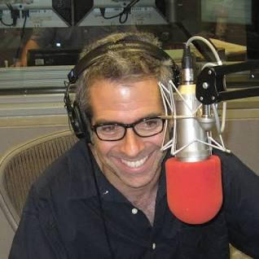
Feedback from Oct. 18 Marco Werman
“I loved learning about plastic clean-up in the ocean.
It was inspiring. I want to do my part to help the environment.”
“Audacious!”
”I’ve been to Togo, too.”
“Very effective, interesting.”
“Marco tells stories, stories, stories.”
“Marco has been everywhere. I want to travel, too.”
“Peace Corps is a good career option.”

Slide 3

Class Administration pick up your copy of…
San Diego Business Journal Book of Lists
Rotary magazines or rotary.org
Browse through your copy
Who or what interests you?

Slide 4
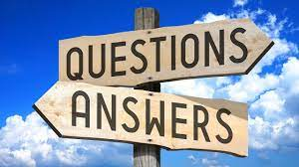
Class Participation: Guest speakers formal Q-A
Wendy Urushima-Conn
Kent, Sarah, Kevin, Camden, Erik, Shiu?
Marco Werman
Nam, Sarah, Filippo, Erik, Luay, Philip
Next guest speaker, Jonathan Hanwit
Challenging ESG (clippings from WSJ)
Formulate your question ahead of time
Well facilitated Q-A and agile speaker
can take 12-15 questions.
Get your CP points!

Slide 5
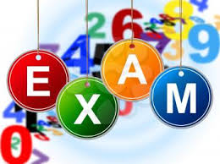
Review for 1st Progress Exam
Open for 24-hrs.
Sunday, 22 Oct. 11 am – Monday, 23 Oct 11am
10% of final grade
20 minutes timed
25 questions
8 cross match, 10 True-False, 7 Multiple choice
Open book, open source.

Slide 6

Review for 1st Progress Exam
Topic # of questions
Getting Beyond Better (cross match) 8
501 (c)(3) 5
Case for Definition (first reading) 4
WSJ (ESG) 2
Assignments 10-4 and 10-9
Chart Table Differences, CPA’s guide 2
Videos 2
You are accountable for all assignment in syllabus.
Hints: “Athena is your friend.”
Red highlight in daily modules.

Slide 7

Networking Skills
Six Degrees of Separation
“A friend of a friend can be made to connect
any two people in a maximum of six steps.”
– Frigyes Karinthy (1929)
– John Guare (1990)

Slide 8
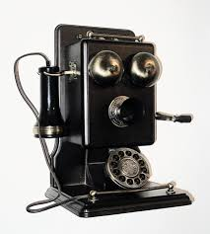
Networking skills
Hierarchy of communication
Pillow talk
Eyeball to eyeball
Skype, FaceTime, WeChat, other 2-D social media
Telephone conversation or voice mail
Facebook, WhatsApp, YouTube, Tiktok, Instagram, LinkedIn, other visual
Text, e-mail, twitter, other
It changes every day. Best to use every sensory tool possible.

Slide 9
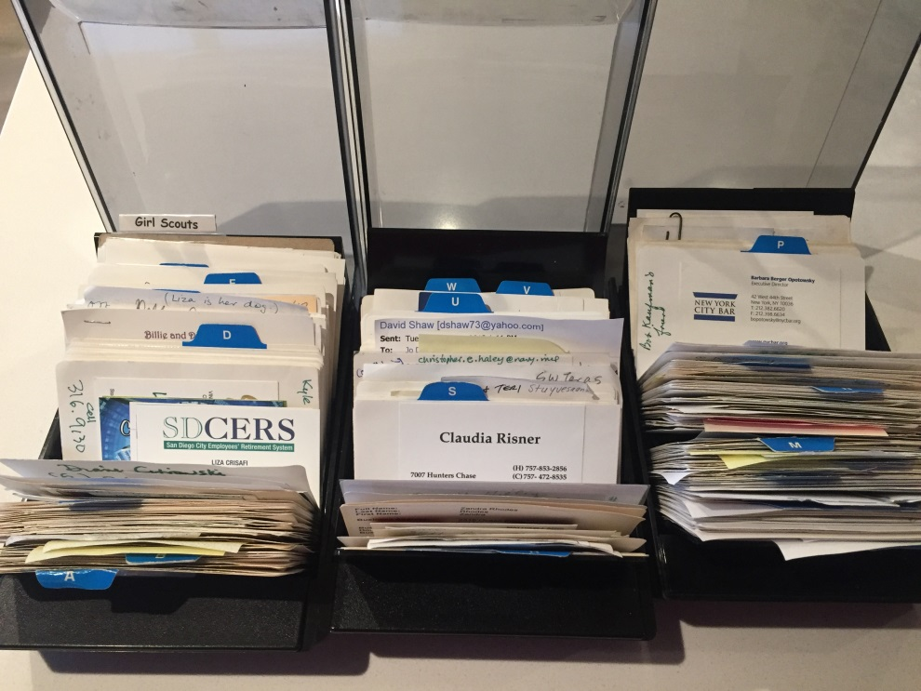
Networking skills
Yesterday…
Rolodex!
Business cards, calling cards
Membership rosters, company social roster, Christmas card lists, “The Little Black Book”
3-martini lunches
Today…!!!!????

Slide 10
Networking skills
Still useful
Family and friends
Service clubs
Associations
Social events
Houses of worship
Your Professors
Your UC San Diego classmates!

Slide 11
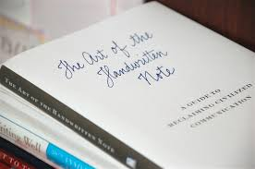

Networking skills
A handwritten note
can trump all!

Slide 12
Networking exercise Class essay due Wednesday, 22 Nov.
Your journal is your essay
In-person interview with someone you don’t already know
Author, philanthropist, celebrity, your choice
Social Entrepreneur from readings Bert W
WSJ reporter
Rotary magazine, SDBJ Book of Lists
Zoom interviews must be approved in advance
NTE 2 pages (+attachments, screen shots OK)
15% grade (term paper)

Slide 13
Networking exercise Class essay due Wednesday, 22 Nov
Thank you note, stamped ready to post
Sample essays (rubric) posted in Canvas
Pre-approval to partner with classmate, submit same paper
Goal: Establish a relationship with someone who inspires, interests you
Get out of your comfort Zone

Slide 14
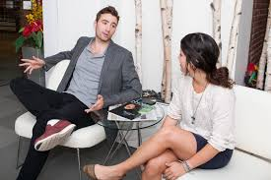
Term Paper grades (previous classes)
A
Early start
Ambitious goal “Dream Big”
Overcome obstacles
Face-to-face interview
B
Not a stretch
Zoom when you could have met in person
C
Success, but reliance on e-mail
No thank you note, evidence of interview
#1 reason for lower grade…
procrastination

Slide 15
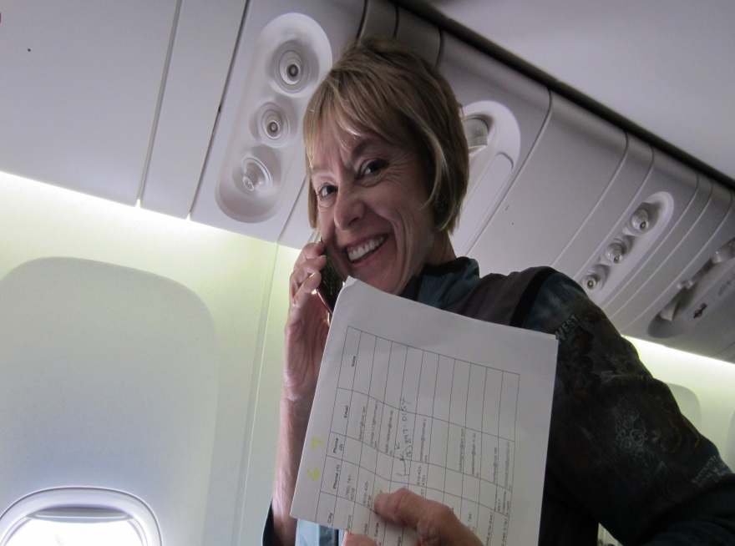
Networking … the cold call
“Soliciting business from a customer (prospect, potential financial supporter) without any prior contact from the caller (salesperson).”
Generally referred to as an over the phone process… telemarketing… door-to-door.”

Slide 16
Steps in a successful cold call
Navigate the 6-degrees of separation
Appropriate use of “name dropping”
The “soft ask” (e-mail, LinkedIn, visuals)
Honor the prospect’s time
Goal of the cold call: Get the appointment! (75% rule)

Slide 17
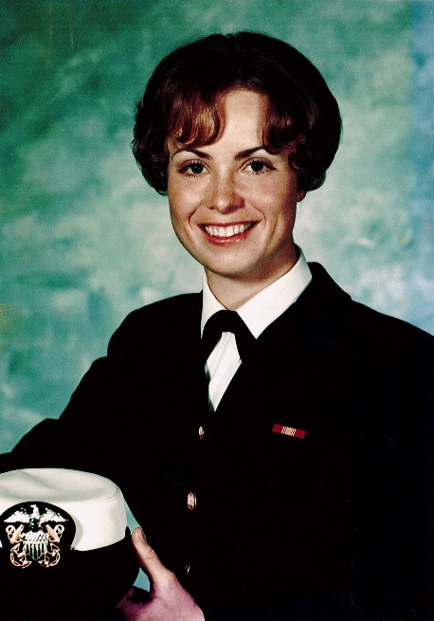
Networking … the cold call
“The Cold Call is an essential
business skill.
Cold Calling is a life skill.
Master it.”
Jo Dee C. Jacob
Captain, USN (ret.)
Officer Recruiter of the Year

Slide 18
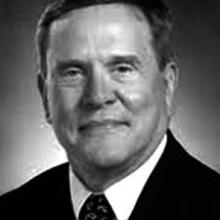
Networking … the cold call
“Make them get out of their comfort zones.”
C. Clark Jordan, Ph.D.
Assistant Dean
Rady School of Management

Slide 19
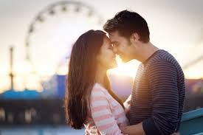
Steps in a successful cold call
Business is just like dating …
Dating is just like business.

Slide 20
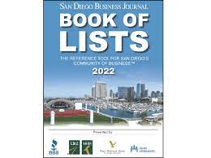
San Diego Business Journal Book of Lists

Slide 21
How to Navigate Rotary Magazine
Look for by-line (reporter)
Credits p.4
Inquiries, professional staff
Marketing layout and photos
Rotary projects around the Globe approx. p.16
Rotary Conversation
Substantive interview, always inspiring
Download Rotary Club Locator app

Slide 22
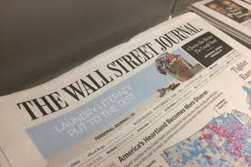
Tips on how to reach a prospect in Wall Street Journal
VM message or cold call
“Contact us” link. Subject line “Pass to ___”
Introduce self, (senior) at UC San Diego, taking a class in Social Entrepreneurship. Assigned a networking project. Our professor says (reporters) are very good networking contacts. Do you have a moment to talk? May a schedule a better time to call?
I’m (inspired) (interested) in your story published in the (date) edition of WSJ. I’d like more information about the (topic).
Then back-stop VM with an e-mail.

Slide 23
Tips on how to reach Rotary
VM message or cold call
Introduce self, a senior BE major at UC San Diego, taking a class in Social Entrepreneurship. Assigned a networking project. Our professor says Rotarians are very good networking contacts. Do you have a moment to talk? May a schedule a better time to call?
I’m (inspired) (interested) in your project ___reported in the (date) ___edition of Rotary Magazine. I’d like more information about the Peace Scholars program
Backstop with e-mail

Slide 24

Activity
Team up by same magazine cover
Discuss an article that interests you
“Pitch” your favorite
When you reach consensus, return to seat

Slide 25
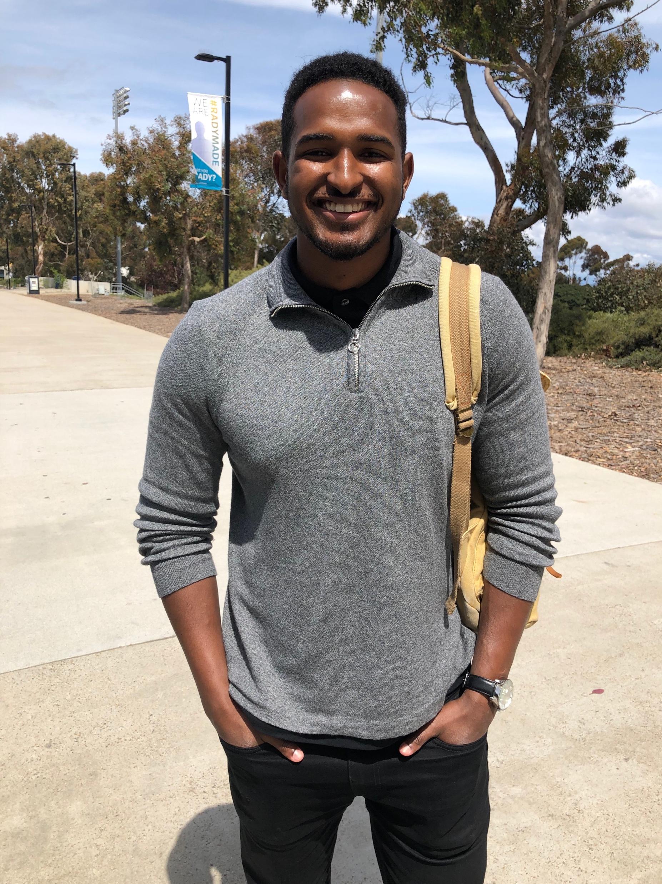
Fred Grier MGT167 Alum F18

Slide 26
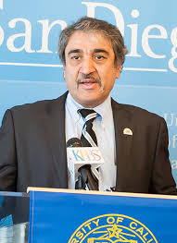
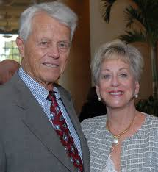
Take-aways Get out of your comfort zone, get on your feet Be ready for opportunities and say, “Yes!” Follow-through, write notes, stay in touch

Slide 27

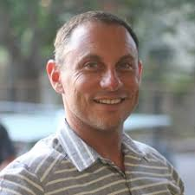
Next class, Monday, Oct. 23
Passion Pitch Round 1 (2)
ESG
Readings posted in Canvas
Guest Speaker Jonathan Hanwit
CEO+CO-Founder
thinkParallax

Slide 28

Drawing for Girl Scout Cookies

Slide 29
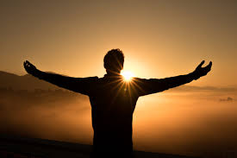

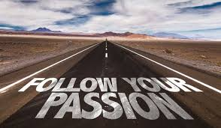
Passion Pitches

